Slide 1

www.computerscienceuk.com

Slide 2


Activity 1
3 minutes
When you find yourself with a problem (lost keys, can’t remember how to complete a homework assignment etc)…
…how do you think about solving the problem?

Slide 3
Learning Habits
Which ‘Learning Habits’ we will need to make use of to be a success in this lesson?
Noticing details
Adapting :
Reflecting and making changes
Reasoning:
Thinking rigorously, methodically and giving explanations.
Empathising…
…with feelings and views
Effective use of time
Questioning:
Asking questions to get below the surface
Listening…
…to understand
Imagining…
…how things could be and seeing a range of possibilities
Distilling…
…what you have learnt and what you need to learn
Collaboration:
Working effectively with others
Meta Learning:
Talking about how you have been learning
Imitation:
Picking up good habits from others
Independence:
Working effectively alone
Managing distractions…
…and sustaining concentration
Capitalising:
Using resources purposefully
Perseverance:
Overcoming frustration and difficulty
Planning…
…your learning in advance

Slide 4
Lesson Objectives
Lesson Objectives
To understand the importance of using ‘problem solving’ techniques when solving problems.
To understand the meaning of ‘Abstraction’, ‘Decomposition’, ‘Pattern Recognition’ and ‘Algorithmic Thinking’.
Success Criteria
ALL: To be able to explain what ‘Abstraction’, ‘Decomposition’, ‘Pattern Recognition’ and ‘Algorithmic Thinking’ is.
MOST/SOME: To also be able to apply these techniques when solving a range of problems.
Literacy – Key Words
Abstraction | The removal of irrelevant detail in order to focus on the problem at hand.
Decomposition | Breaking down problems into smaller sub-problems so that they are easier to solve.
Algorithmic Thinking | Thinking about the logical steps required to solve a problem

Slide 5
Computational Thinking
Introduction
Computational thinking is an approach to problem solving
Computational thinking is about taking a complex problem and being able to use several ‘computation thinking techniques’ (abstraction, decomposition, pattern recognition and algorithmic thinking) to:
  Fully understand the problem
  Create an effective solution.
This problem solving approach is not only important for programmers when devising software solutions, it is also an approach used in all areas of science to effectively enable complex processes to be understood.

Slide 6
Computational Thinking
Problem Recognition
Step one of problem solving is being able to define the problem.
A problem is well-defined if there is;
A Clear Initial Situation
A Clear Goal
Clearly Defined Resources
Clear Defined Constraints
Clearly defined Initial Situation
Clearly defined resources
Clearly defined Goal
Clearly defined constraints

Slide 7



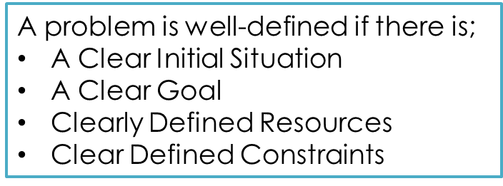
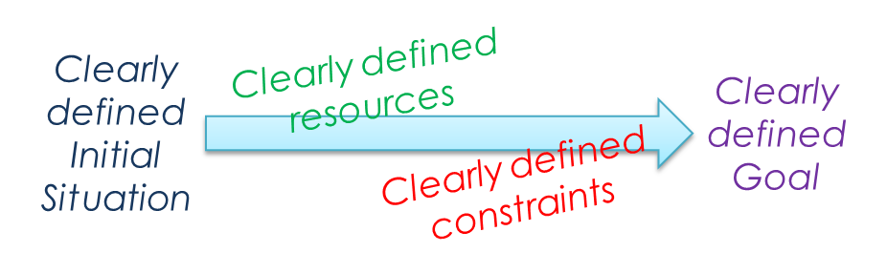
Computational Thinking
Example of a Clearly Defined Problem
The Camels
Four camels traveling on a very narrow ledge encounter four camels coming the other way.
As everyone knows, camels never go backwards, especially when on a precarious ledge.
The camels will climb over each other, but only if there is a camel sized space on the other side.
The camels didn't see each other until there was only exactly one camel's width between the two groups.
How can all camels pass, allowing both groups to go on their way, without any camel reversing?
Initial Situation | Camels stuck on a narrow ledge
Goal | Camels need to get past
Resources | Can climb over each other but only if there is a camel sized space the other side.
Constraints | They cannot go backwards. There is not enough space to pass side by side.

Slide 8
Computational Thinking
Can all problems be solved by a computer?
If a problem requires a software solution it must first be decided if it is solvable computationally.
In other words, can the problem be solved by means of an algorithm?
If so, then computational thinking techniques can be used.
It must be noted that not all problems can be solved computationally.

Slide 9
Computational Thinking
Solvability
Are all problems solvable?
Not if it requires an infinite amount of time to solve
e.g. finding every prime number
Are all solvable problems computable?
Not really if they take an extremely long yet ‘less than infinite’ time to solve. These are known as intractable problems. Here, it is sometimes best to take a heuristic approach – where we use our experience to produce a ‘good enough’ solution.
e.g. finding the shortest distance between an increasing number of locations
So what problems are computable?
Any problem that can be solved in reasonable time (polynomial or less). These are known as tractable problems.

Slide 10

Computational Thinking
Computational Thinking Techniques
There are 4 main techniques that underpin computational thinking.
Computational Thinking
They are:
Abstraction
Decomposition
Pattern Recognition
Algorithms
Abstraction
Decomposition
Pattern Recognition
Algorithms

Slide 11
Abstraction

Slide 12
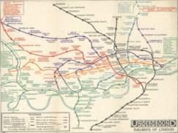
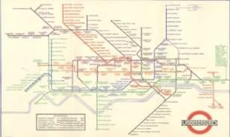
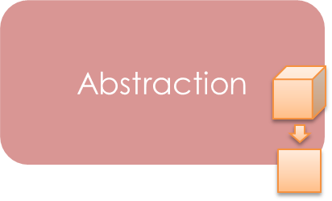
Computational Thinking
What is Abstraction?
Abstraction is about moving from the real to virtual.
It is concerned with simplifying the complex by only dealing with the important and neglecting the unnecessary.
The London Underground map is a great example of Abstraction.
The map ignores features that are not important to the passenger such as turns, distances between stations and instead provides a simplified view of journeys so that it is more simple to follow.
The unnecessary information has been removed.
This is a vital feature of computational thinking, to solve complex problems, we need to be able to focus on what is important and ignore the unnecessary.

Slide 13
Computational Thinking
Why do we need abstraction?
Simplify processes to better understand them.
Remove the irrelevant to help us increase our chances of solving a problem.
To help us virtualise the organic – which in turn helps with the method of programming

Slide 14
Computational Thinking
Differences between abstraction and reality
On the previous slide it was said that abstraction is needed…
“To help us virtualise the organic – which in turn helps with the method of programming”
Abstraction is a representation of the real world.
Consider variables; they are a virtual representation of the real world.
For example, the speed of car may be represented by a variable which contains the data 60mph.
In object oriented programming, objects represent objects in real life. An object will be an abstract model of a real object. It will contain information about the object (what it is and what it does).
Being able to successfully perform abstraction is vital to successful computing.

Slide 15


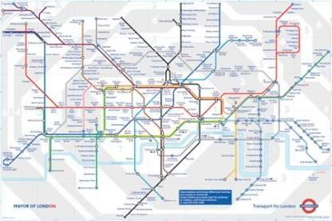
Computational Thinking
Levels of Abstraction
As we know, abstraction is a way of simplifying to make it more usable.
It is important to recognise that abstraction can occur at different levels – that is ‘viewing something at different levels of simplicity’.
Here you can see how the maps loses certain details through the various levels of abstraction.
Level 1
Level 2
Level 3

Slide 16
Computational Thinking
Layers of Abstraction
Within a level of abstraction there will potentially be various layers of abstraction too.
Again, looking at a tube map, different lines have different colours, there are different symbols for stops, stops with connections, stops with over-ground lines etc.
Each of these features is a layer of abstraction and is there to make the map more useable for the map reader.

Slide 17
Computational Thinking
Remembering OOP
An object oriented approach looks at solving problems using the idea of abstraction:
The programmer will think about the various real objects in the world which are relevant to the problem that they are trying to solve (e.g a car in a racing game or humans and money in banking software etc) and virtualise these objects by creating software objects.
The process of virtualising these objects is an example of abstraction.
By virtualising the objects they are ensuring that the things these objects are (attributes) and the things these objects can do (methods) are those relevant to the solution. The programmer will therefore ignore all the other unimportant features about that real life object.
For example, if a programmer wanted to create some banking software, they will obviously need to ensure that the program has users. In an OOP approach, these users would be human objects and when designing these objects they will be giving these human objects the attributes and methods required to enable the program to function and ignore all the other features about the users such as hair colour, height, skin colour, as these are not important in making the program fully functional.
OOP is therefore a great example of abstraction.

Slide 18
Computational Thinking
Class Diagrams
We can define the class for an object in a diagram.
It simply describes the NAME, ATTRIBUTES and METHODS for a class.
Obviously a user will have hundreds or attributes (skin colour, gender etc.) and hundreds of methods (speak, eat, laugh etc.)…
…but as most of these are not relevant to the software problem, they are ignored when creating the user class and therefore software objects.
…again, an example of abstraction.
Class Name:
User
Attributes:
Name
Age
Nationality
Methods:
Deposit
Withdraw

Slide 19
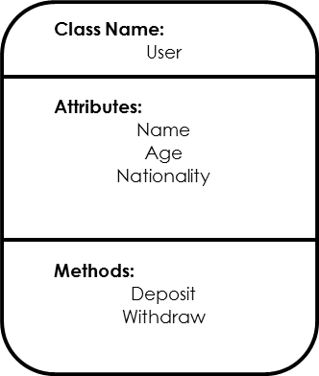
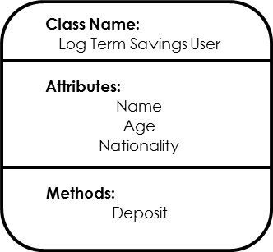
Computational Thinking
Class Diagrams
In OOP we can also use inheritance so that slightly altered classes can be derived from a parent class:
…again, a further example of abstraction.

Slide 20
Decomposition

Slide 21
Computational Thinking
Problem Decomposition
Once a problem is recognised, defined and accepted as solvable, the next job is to solve it.
Often its too big a task to solve it in one go, so problems are better solved broken down into sub problems.
This is decomposition, also known as the ‘Divide and Conquer’ technique…
… by dividing the problem, we can conquer it!
Methods may include producing a Top Down / Stepwise refinement diagram to help break the problem down.
Large Complex Problem
Problem Element 1
Problem Element 2
Problem Element 3
Sub Problem Element 1
Sub Problem Element 2
Sub Problem Element 1
Sub Problem Element 2
Sub Problem Element 1
Sub Problem Element 2

Slide 22
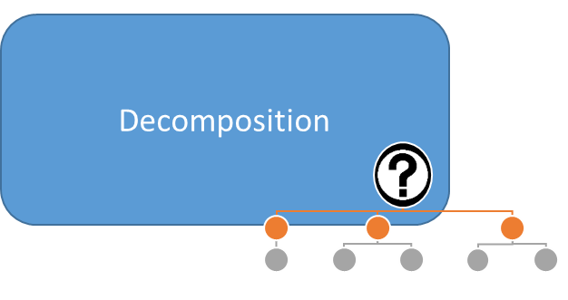
Computational Thinking
Components of a solution?
After decomposition, the next stage is to turn the component parts of a problem into the component parts of a solution. Due to decomposition, this is a far more manageable task and encourages modular programming
Sub Problem
Sub Solution
Now that we have broken the problem down into its component parts, we are ready to solve each component.
Large Complex Problem
Problem Element 1
Problem Element 2
Problem Element 3
Sub Problem Element 1
Sub Problem Element 2
Sub Problem Element 1
Sub Problem Element 2
Sub Problem Element 1
Sub Problem Element 2

Slide 23
Computational Thinking
Mobile Phone Example
Programming the software for a mobile phone would be too difficult to achieve in ‘one go’.
So, by using the skills of decomposition, the features of a phone can be identified, which in themselves are sub problems of the task.
Now, the programmer can think about solutions for each of the sub problems identified and can begin writing modules for each aspect, which can then later combine as the phone’s software.
Mobile Phone
Calls
Contacts
Texts
Incoming
Outgoing
Entering
Searching
Receiving and Reading
Composition

Slide 24
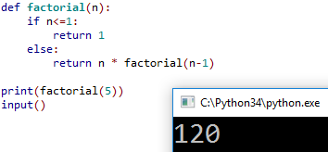
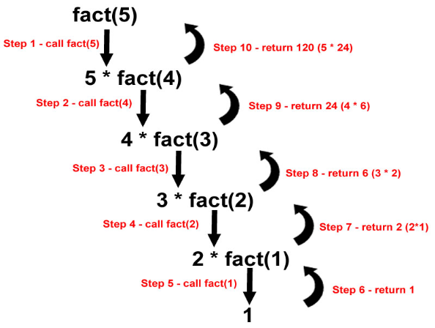
Computational Thinking
Problem Decomposition
Furthermore, sometimes, when a problem is broken down enough, we can see that a problem can be solved with a few lines of code, which can be run recursively to find the solution.
For example, if within a program we eventually realised that we needed to work out the factorial of a number, recursion can be used to calculate the factorial of any given number in just a few lines of code:
The factorial of a number is the product of all positive integers from 1 to the number. In mathematical notation, a factorial is represented by the symbol ” ! ”.
For example, 5! = 5 * 4 * 3 * 2 * 1 = 120

Slide 25
Pattern Recognition

Slide 26
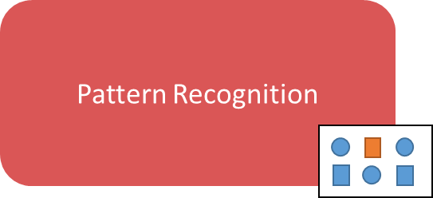
Computational Thinking
What is Pattern Recognition?
Pattern recognition is an important computational thinking tool. It concerns the idea that similar solutions or processes (that have already been studied) can be applied to help solve the problem that one might be working on.
If we were a chef in a restaurant and had an important customer who want a brand new ‘Super Special Pizza’ for lunch, we would first have to create a recipe.
But a more effective approach would be to recognise that a ‘Super Special Pizza’ is similar to a ‘Standard Pizza’, just with a range of different toppings.
So, to be efficient, we would borrow the pizza recipe so that half the problem is already solved, and just solve the remaining aspects of the problem.
Programming languages have many libraries of functions / classes which we can make use of to solve many aspects of complex problems without having to code from scratch every time.

Slide 27
Computational Thinking
Preconditions and Reusable components?
In addition to using prewritten code libraries to make the job of problem solving easier, it is also vital that programmers ‘think ahead’ to see if there are any modules of code (which they write) that could be reused in other projects that they might be working on, later down the line.
For example, a programmer may have written some code which contains an algorithm for a unique calculation that a particular organisation uses in many aspects of its work.
It may therefore by likely that this code will be essential in future programs required by the organisation. It would therefore be sensible to code this algorithm in a separate module which could be imported into future program with ease.

Slide 28
Computational Thinking
Programs ‘Thinking Ahead’
Caching
A technique that a computer scientist may implement into their programs to ensure that they are as efficient as possible is caching.
Caching is where inputted data is stored in RAM, just in case it is needed again before the process has been ended.
Similarly, prefetching is where instructions are moved from the RAM to the CPU’s cache, before it is actually needed. Well developed algorithms can predict future instructions and so by ‘prefetching’ them, it means that are ready to be used instead of waiting for them to be read from disk.
Advantages:
Faster response times as data doesn’t need to be read from disk – they are already in system memory.
Reduces the load on a system (fewer data access movements)
Disadvantages:
Very hard to program and apply successfully.
If the wrong data is cached, the program could end up running slower.

Slide 29
Algorithms
&
Algorithmic Thinking

Slide 30
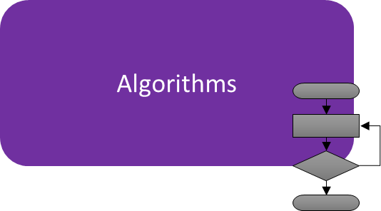
Computational Thinking
What are Algorithms?
Algorithms are simply recipes / procedures used to get the intended result.
Algorithms state the steps required to get to the desired result.
As we learnt earlier, for a problem to be computable, an algorithm must be produced.
Creating algorithms is all about thinking logically and so to think computationally is to think in a structured, organised and logical manner.
Algorithms are vital to programming. Without one, coding a solution is almost impossible…but with one, coding becomes an easy job (if you know your programming syntax that is!)

Slide 31
Computational Thinking
Algorithms and Decisions?
At the heart of all substantial algorithms are decisions; points at which the program might take a significant direction based on particular conditions.
These decisions will either lead to an iteration or a branching point, which may be central to the program’s function.
It is therefore vital that the points in the algorithm when decisions occur, are correctly identified.

Slide 32
Computational Thinking
Decisions and Conditions
In programming, all decisions are based on Boolean conditions…conditions that are either True or False.
Take for example the following…
IF x > y:
OUTPUT “X is greater than Y!”
This IF statement is checking to see if the condition x>y is TRUE. If it is then the message with be output, otherwise it will not.
When designing an algorithms it is essential that the conditions of various data (at pivotal parts of the program) are correctly analysed, so that the program can function as it is intended.

Slide 33
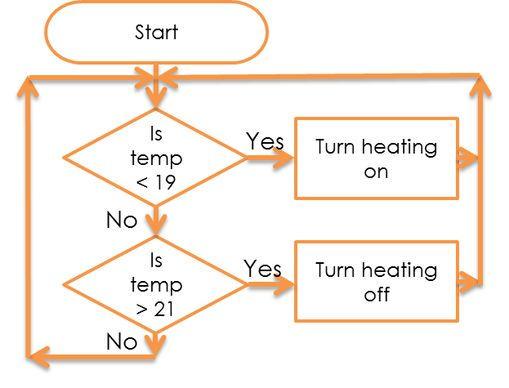
Computational Thinking
Decisions and Flow
As we have just seen, decisions will occur at points where the program might take a significant direction based on particular conditions.
The direction of the program is called ‘FLOW’.
To help us plan out the logic for an algorithm we can use pseudocode and/or flowcharts.
These can help us visualise the flow of an algorithm for all possible conditions.
Example:
A central heating system will try to keep the temperature between 2 values (19 and 21)
If the temperature falls below 19 It will turn the heating system on
If the temperature rises above 21 it will switch the heating system off.

Slide 34
Computational Thinking
The Order of Events
When planning out a solution to a problem, it is important to identify whether ‘Order’ is important.
Sometimes, the order of the steps required to solve a problem will be vital to the success of the program.
Consider the processes involved in purchasing goods online.
If these events were to occur in a different order, then there may be issues for either the customer or the retailer.
However, sometimes the order of steps is not important – in fact sometimes the need for a program to function in any given order is a must!
Stock Checked
Financial and Delivery Details Provided
Check Bank for Sufficient Funds
Transfer Money
Reduce Stock

Slide 35
Computational Thinking
The Order of Events
In ‘Event Driven’ programming, the programmer needs to ‘compartmentalise’ much of their code so that the user can ‘call upon’ the required processes when they wish.
Any program which makes use of a ‘Graphical User Interface’ (GUI) with buttons and other interactive widgets is ‘Event Driven’.
In these programs the program will run a special piece of code called an ‘Event Loop’ and will wait for the user to provide an event (such as a button click).
Once the event occurs, it is added to the event queue and the program will then respond to each event in turn.
The important thing to realise here is that the programmer will never know the order in which a user will interact with the program’s features and so it is vital that code is organised in such a way that the appropriate code can be called upon when the user requires it.

